Slide 1
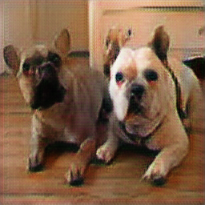
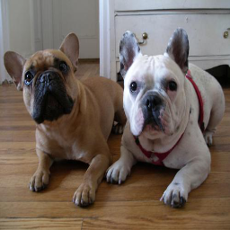
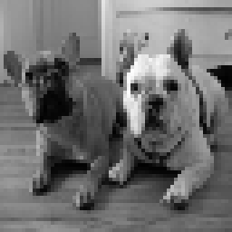
Image Super-Resolution and Colorization in a single Generative Adversarial Network
Erez Yosef erez.yo@gmail.com | Shay Shomer Chai shay5510@gmail.com
School of Electrical Engineering, Faculty of Engineering, Tel-Aviv University, Israel.
CSRGAN

Slide 2
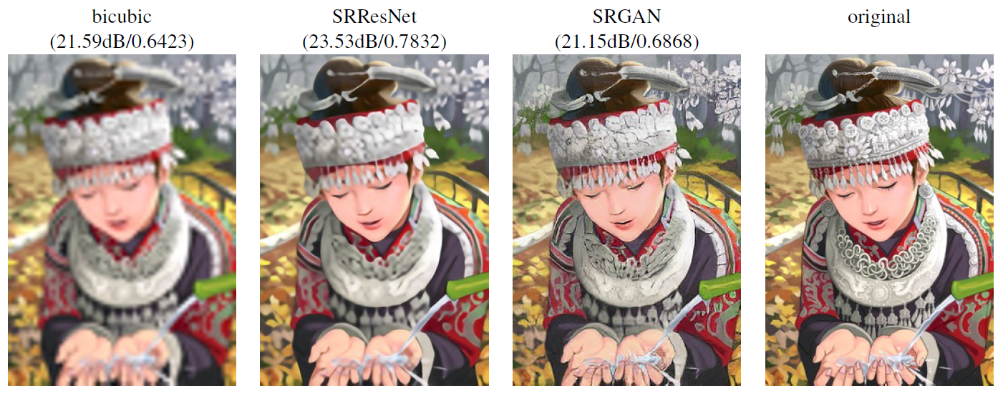
Introduction: Image Super Resolution GAN
Source: Photo-Realistic Single Image Super-Resolution Using a Generative Adversarial Network Ledig et al. 2018

Slide 3
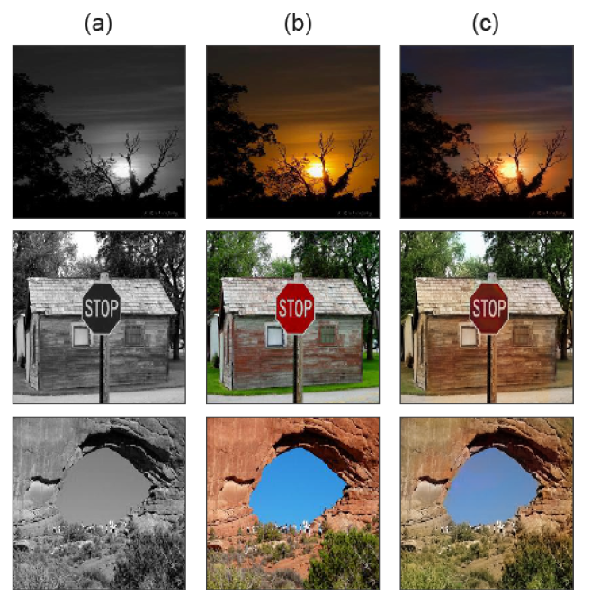
Introduction: Image Colorization GAN
Colorization results with Places365
Grayscale.
Original Image.
Colorized with GAN.
Source: Image Colorization Using Generative Adversarial Networks
Nazeri et al. 2018

Slide 4

The Task
Integrate image colorization and super resolution to single GAN.
Test different architectures and training methods based on previous works.
Get best results using the best network.
Learn more about GANs.

Slide 5

The challenges
Global information in colorization VS local information in SR.
Deep networks are hard to train.
No previous work integrating colorization and super resolution.

Slide 6
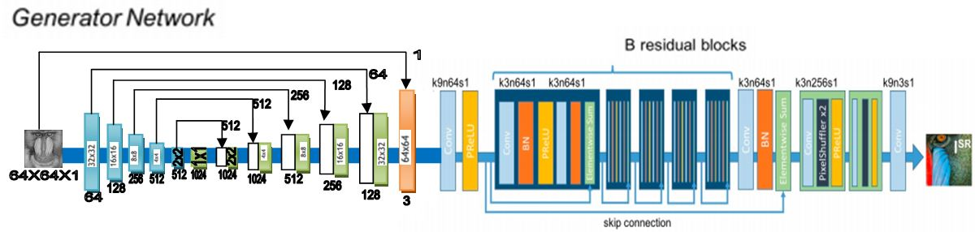
Baseline Network
The baseline Generator:
256X256X3
Generator base line architecture. Source: partially from Ledig et al.

Slide 7
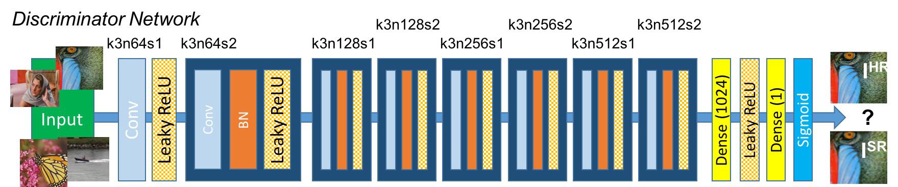
Baseline Network
The baseline Discriminator:
Discriminator architecture. Source: Ledig et al.

Slide 8
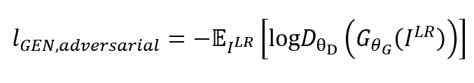
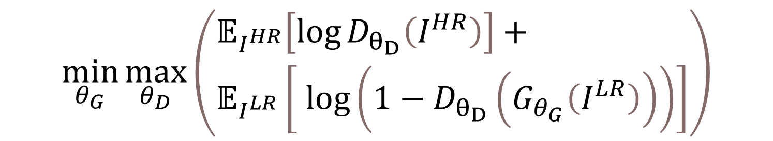
Methods - GAN
Adversarial loss: min-max problem (Goodfellow et al.)
Generator adversarial loss:
$$\min_{θ_{G}}{\max_{θ_{D}}\left(\begin{aligned}&𝔼_{I^{HR}}\left[\log{D_{θ_{D}}\left(I^{HR}\right)}\right]+ \\ &𝔼_{I^{LR}}\left[ \log\left(1−D_{θ_{D}}\left(G_{θ_{G}}\left(I^{LR}\right)\right)\right)\right]\end{aligned}\right)}$$

Slide 9
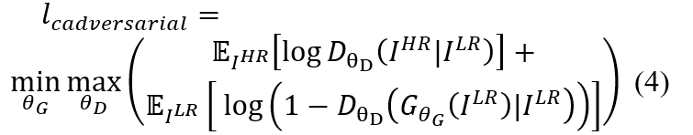
Methods – Conditional GAN
Conditional adversarial loss: min-max problem (Mirza and Osindero)

Slide 10
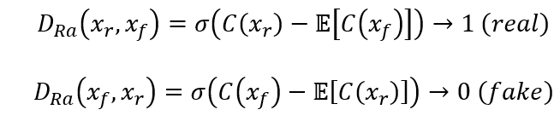
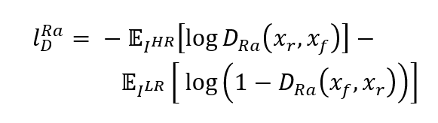
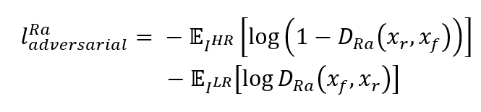
Methods – RaGAN
Relativistic average GAN:
Adversarial loss:
Generator loss:

Slide 11
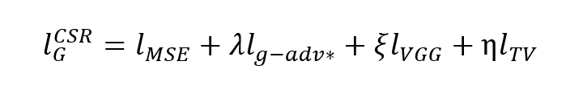
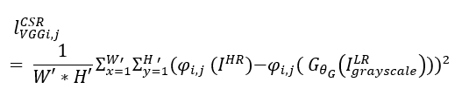
Methods – Content loss
Generator content loss:
VGG loss:

Slide 12
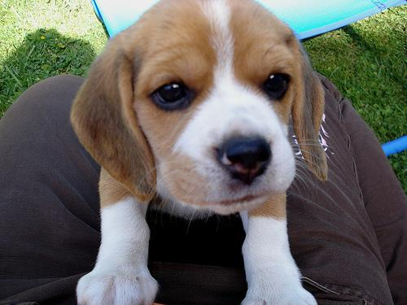
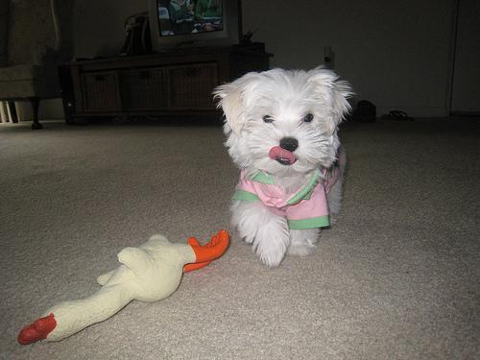
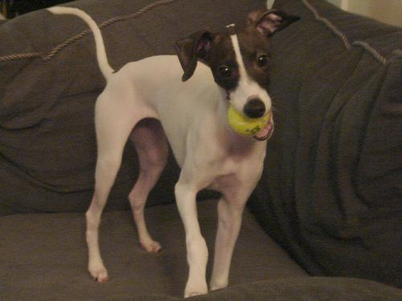
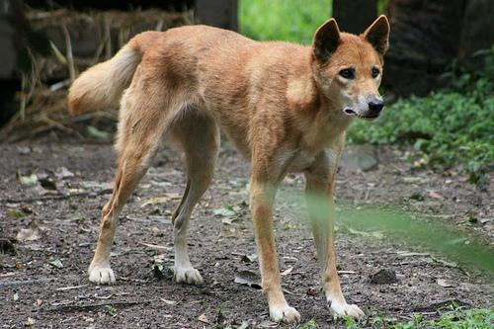
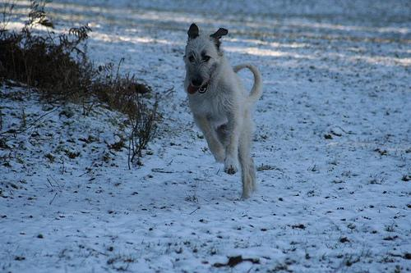
Data
Stanford dogs dataset ~20K images of 120 dog breeds.
Smaller dataset for architecture testing: ~2K images of ~10 dog breeds.
Larger dataset for the chosen CSRGAN: ~6K images of ~30 dog breeds.

Slide 13
Experiments
Baseline
Conditional GAN
Relativistic Average GAN
UBN - un-bottlenecked U-net
RRDB generator
Feature extractor generator - CSRGAN

Slide 14
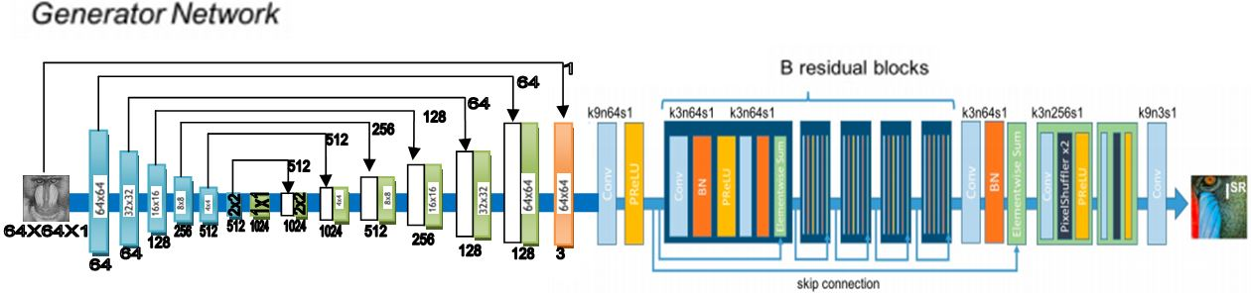
Qualitive Results - Network
Generator: Baseline network with feature extractor layer (Nazeri et al.)
Discriminator: Baseline network.

Slide 15
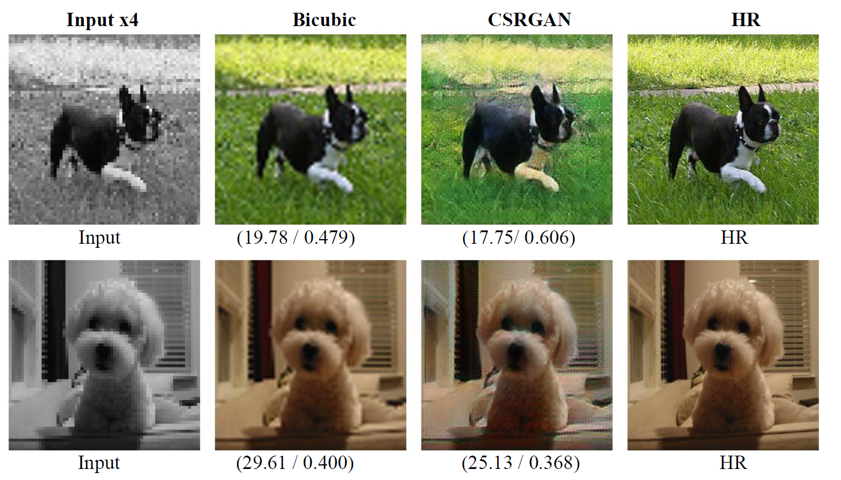
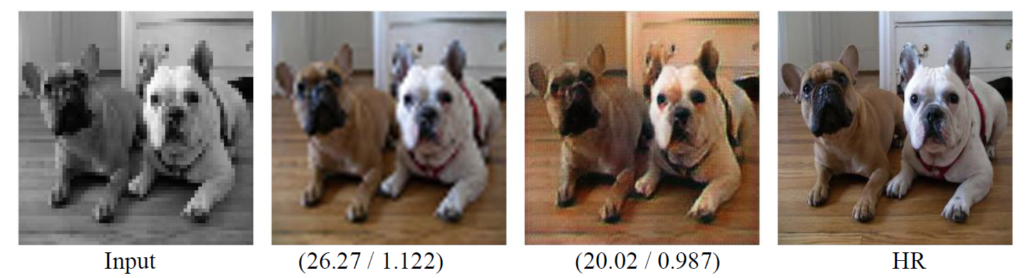
Qualitive Results
(PSNR / VGG-MSE)

Slide 16
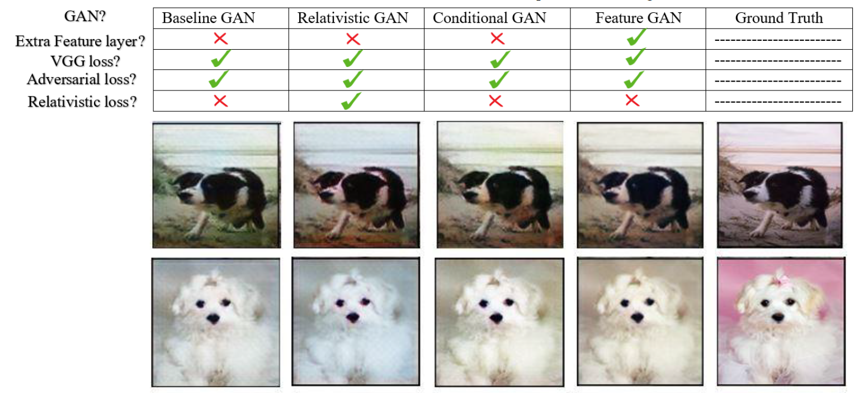
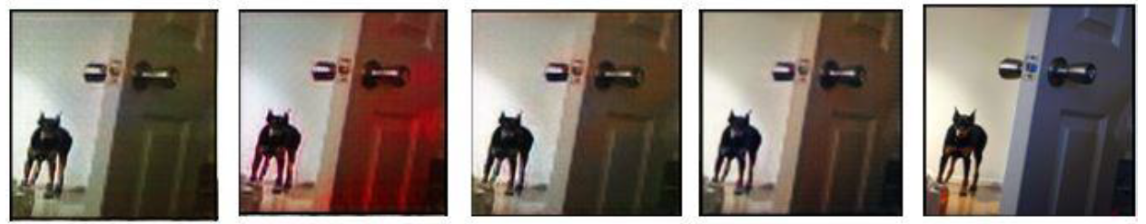
Ablation Studies

Slide 17
Conclusion
We integrate different information tasks: global features and local features.
We achieved good colorization with SR results.
Some methods didn’t provide the improvement we expected.
Small change in the network architecture can have a major impact on the results.

Slide 18

Thank You CSRGAN Team

